Slide 1
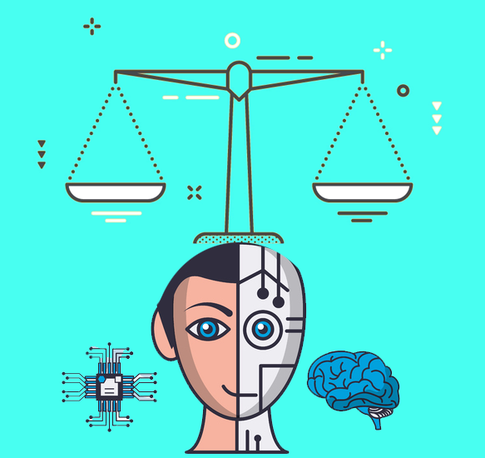
Ethical Implications of Artificial Intelligence in various fields
Abhinav Thupili
Notes:
Image credits : https://www.kasparov.com/the-ethical-ai-paradox-why-better-technology-needs-more-and-not-less-human-responsibility-ai-and-ethics-june-24-2021/

Slide 2
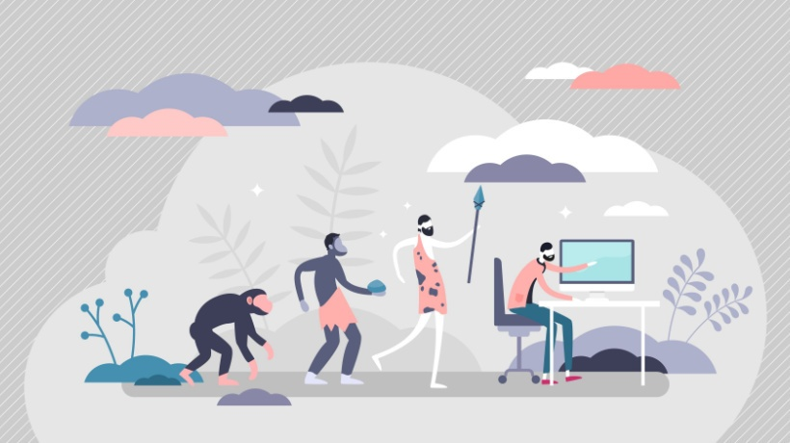
Introduction
Stone tools (2.6 million years ago
Control of fire (1 million years ago)
The wheel (3500 BCE)
Agriculture (10,000 BCE)
Writing (around 3400 BCE)
The compass (around 200 BCE)
Printing press (1440)
Steam engine (1712)
Electricity (19th century)
Antibiotics (1928)
The internet (1960s-1990s)
Computers (20th century)
Notes:
Image credits: https://elearningindustry.com/the-evolution-of-technology-development

Slide 3
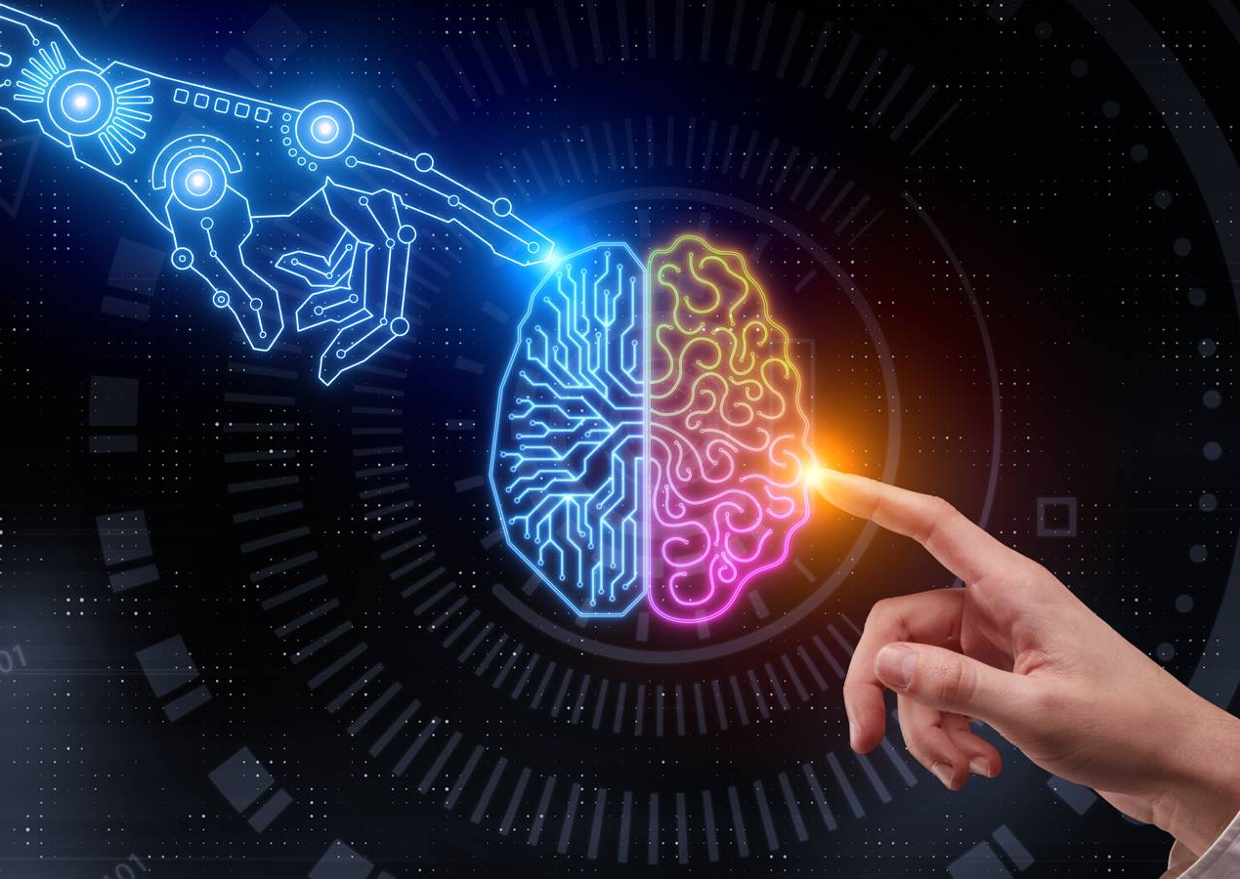
Artificial Intelligence (AI)
Artificial intelligence is when humans create computer programs or machines that can think and learn like us. It's like giving a computer a brain that can solve problems, recognize patterns, and make decisions.
Notes:
Image credits: https://news.microsoft.com/en-my/2021/08/30/how-malaysia-can-navigate-its-future-economy-with-ai/

Slide 4
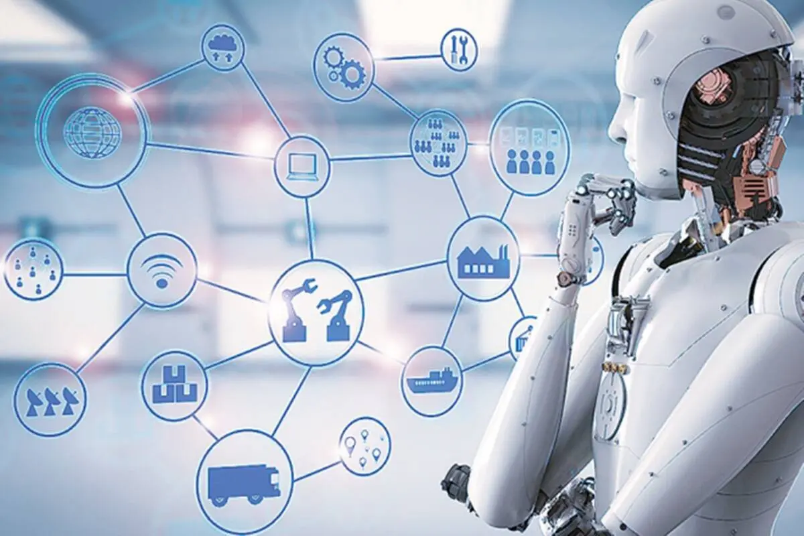
AI: Applications in various fields
Agriculture
Automotive
Education
Energy
Finance
Healthcare
Law
Manufacturing
Marketing
Security
Notes:
Image credits : https://skillsrediscovery.com/artificial-intelligence-introduction-automation-its-applications-and-the-future-of-humanity/

Slide 5
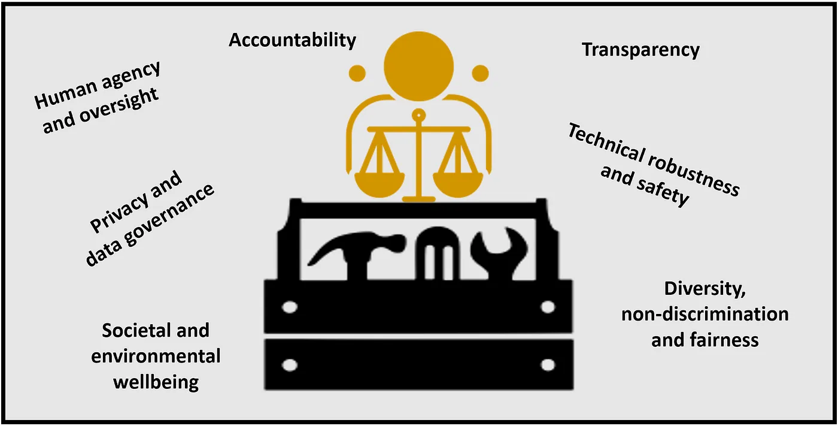
Ethical Implications of AI

Slide 6
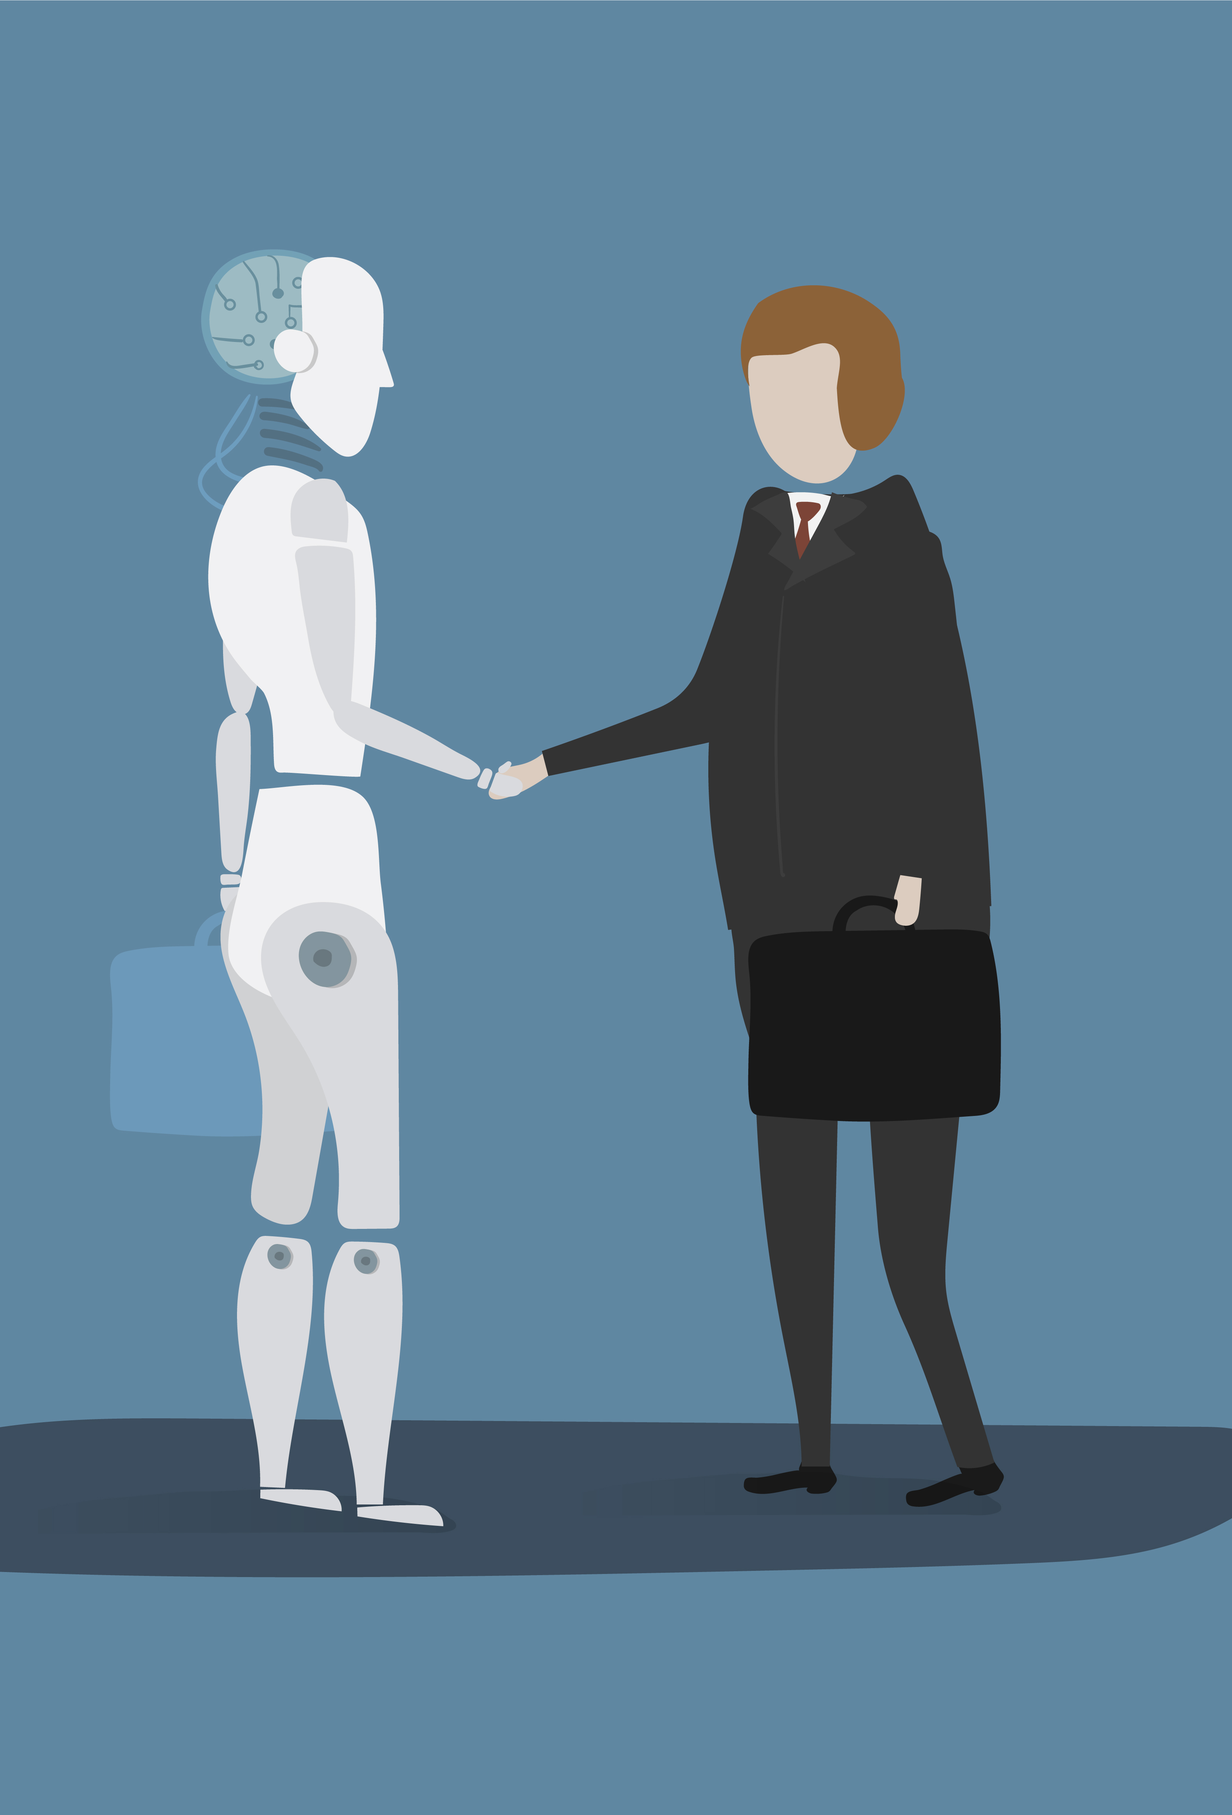
Guidelines for AI
Protect privacy, and consent, and guard against misuse of data.
Address biases in AI systems.
Implement transparent practices and ethical guidelines.
Ensure accountability in AI systems.
Notes:
Image credits: https://www.freepik.com/free-vector/illustration-robot-vector-graphic_2803293.htm#query=ethical%20dilemma%20in%20AI&position=0&from_view=search&track=ais

Slide 7
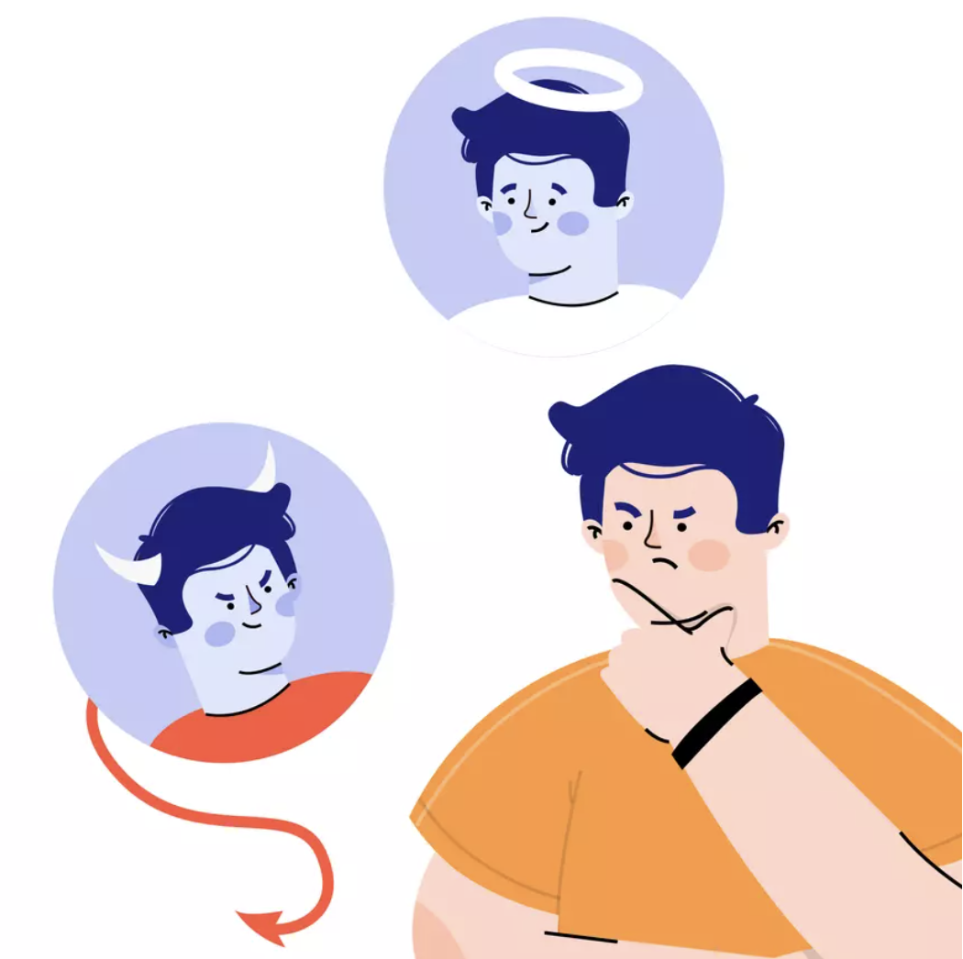
Conclusion
AI - Boon or Bane?

